Slide 1

COS 214 Project
sudo-apt-get-marks

Slide 2
sudo-apt-get-marks members
u22497082 - Ethan Vletter
u22652974 - Carinda Smith
u23632730 - Janri du Toit
u23577674 - Ethan Wilke
u23656175 - James Neale
u23708833 - Megan Pretorius
u23590883 - Marco Paximadis

Slide 3
Introduction

Slide 4
Final class diagram

Slide 5

City Management:
Create and manage different types of buildings.

Slide 6
Buildings
Add class diagram

Slide 7
Buildings
Explain pattern and attributes and methods

Slide 8

City Management:
Manage Utilities
Powerplants : generate electricity to supply to city.
Functional and Non-functional
Water Supply : ensure steady distribution of water.
Functional and Non-functional
Waste Management : handle waste removal and recycling.
Functional and Non-functional

Slide 9
Utilities
Add class diagram

Slide 10
Utilities
Explain pattern , attributes and methods

Slide 11
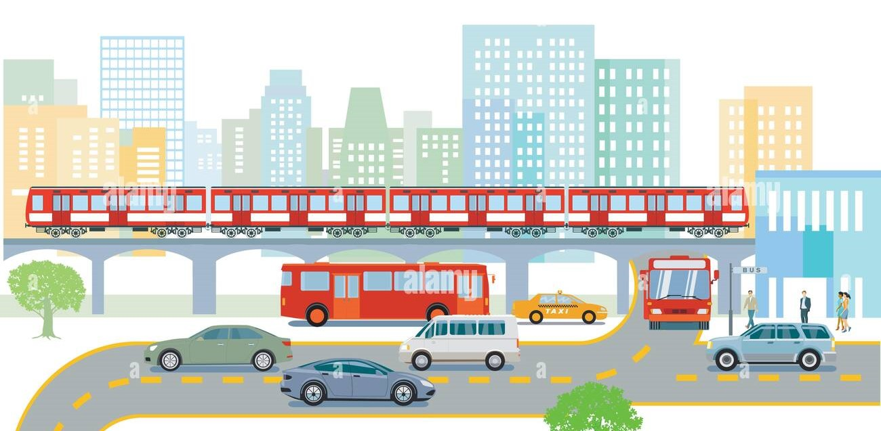
City Management:
Handle Transportation system.
Roads: Basic infrastructure for public transport movement.
Public Transit: Buses to transport citizens to and from place of employment.
Commercial busses transport Commercial Workers to/from
Residence: House to/from Workplace: shop/mall/office on a Commercial road
Government busses transport Government Workers to/from Residence: Mansion to/from Workplace: school/hospital/government on a Government road
Industrial busses transport Industrial Workers to/from Residence: Apartment to/from Workplace: warehouse/plant/factory on an Industrial road
Trains: Transport materials on railways

Slide 12
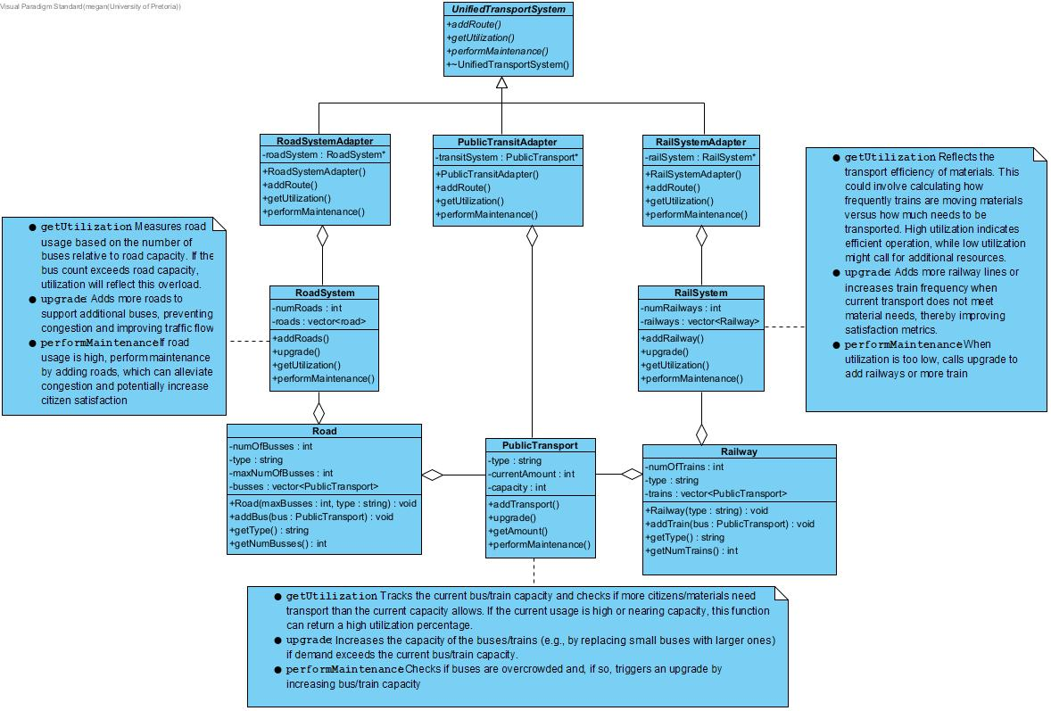
Transportation

Slide 13
Transportation
Explain pattern and attributes and methods

Slide 14
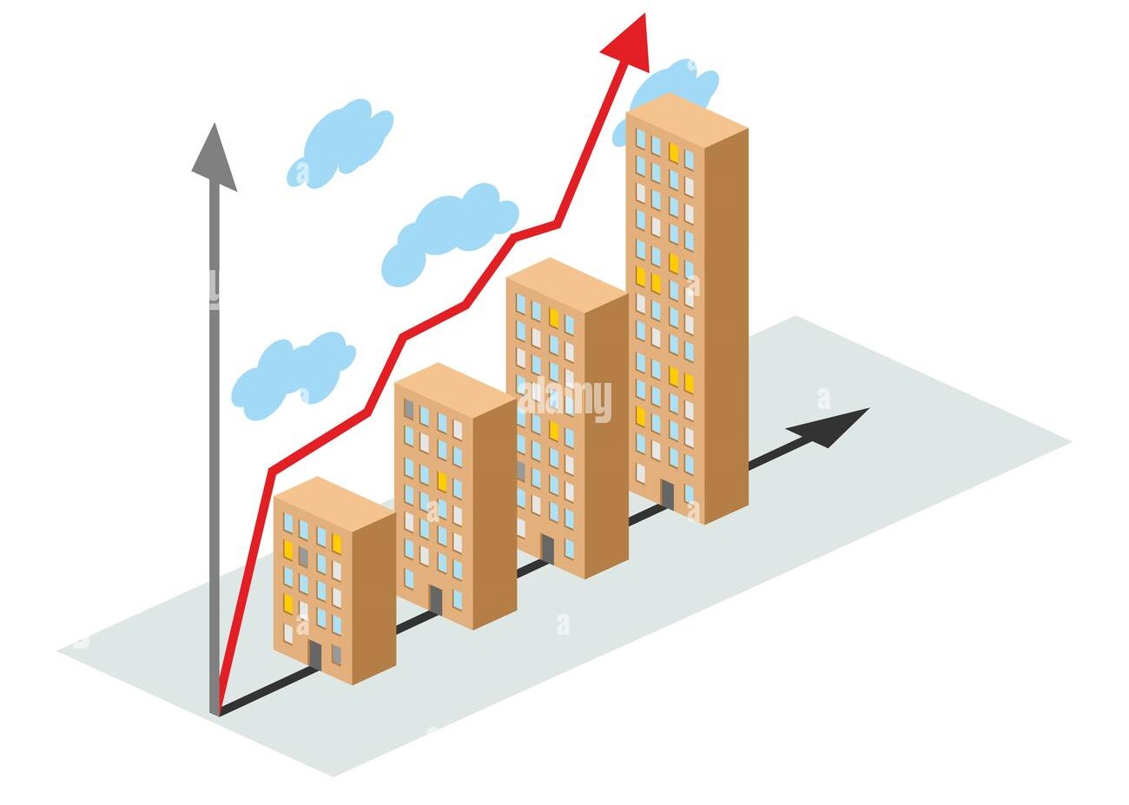
City Management:
City creation and growth Pattern used: Composite pattern
The CityGrowth class inherits from the CitySector class and serves as an overview of the city, such as the different CitySectors and all the types of Buildings in those Sectors as well as Citizens in the Buildings.
CityGrowth contains a vector of all the Sectors in the City.
CitySector contains a vector of all the Buildings in the Sector.
Certain buildings might contain a vector of all the Citizens in the Building.

Slide 15
City Management:
Add class diagram

Slide 16
City Management:
Composite pattern:
Component: CitySector
Composite: CityGrowth
Leaf: Buildings
Leaf and Composite inherit from Component, and Composite may contain multiple children that are Components

Slide 17

Resources:
Explain resources

Slide 18
Resources:
Add class diagram

Slide 19
Resources:
Explain pattern , attributes and methods

Slide 20

Taxes
TaxSystem
Pattern used: Strategy pattern
The TaxSystem has different taxStrategy options to use when taxing Citizens.
The TaxSystem uses CityGrowth to find all taxable Citizens and calculates the tax amount using the desired strategy FlatTaxStrategy will calculate taxes based on the Citizens occupations.
ProgressiveTaxStrategy will calculate taxes based on the Citizens occupations, but this amount will increase depending on the number of Citizens in the City.
Taxes are collected once every 8 moves in the game.

Slide 21
Taxes
Add class diagram

Slide 22
Taxes
Strategy pattern:
Strategy: TaxStrategy
ConcreteStrategyA: FlatTaxStrategy
ConcreteStrategyB: ProgressiveTaxStrategy
Context: TaxSystem
TaxSystem holds and instance of the current selected TaxStrategy.
The Government holds an instance of the TaxSystem and can decide what Strategy to use when Taxing the City.

Slide 23
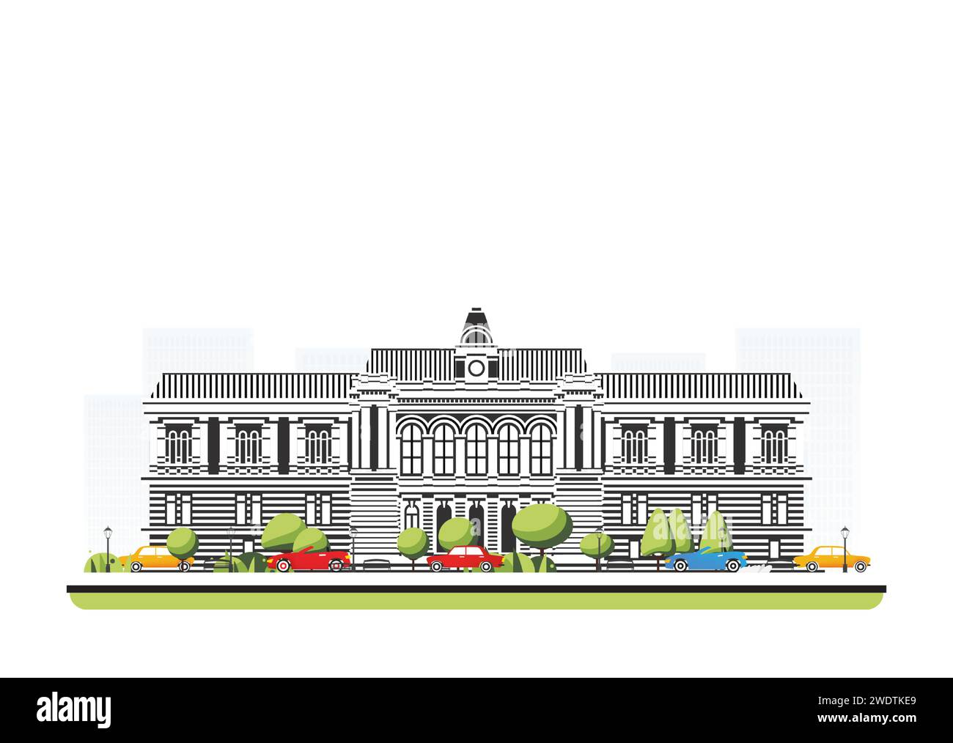
Government
Explain government

Slide 24
Government
Add class diagram

Slide 25
Government
Explain pattern , attributes and methods

Slide 26

Routines:
Commands that the Government call:
Design Pattern: Implements the Command design pattern. Allowing for the government(user) to call the same method on several objects through one function call.
Participants:
Command = GovernmentCommands.
ConcreteCommands = UpgradeAllRoad, UpgradeAllPub, UpgradeAllRail, RenovateAllBuildings.
Invoker = MonthlyRoutines
Client = Government.
Receiver = RoadSystemAdapter, RailSystemAdapter, PubTransportAdapter and Buildings.
Each concrete command stores a vector of their relevant adapter objects. The transport adapters call their performMaintenance() methods when the commands call their execute() methods. This allows for all the transport to be updated through on method call.
Each concrete command is stored in a vector of GovernmentCommands within the MonthlyRoutines class. This allows for the government to call all Transport or all building related commands at once.
The Government keeps a reference to a MonthlyRoutines object which is used to call the commands.
The main commands used are the Transport related commands as there may be insufficient transport for the citizens, which the government can address calling the Upgrade Transport actions to restore the citizens satisfaction.

